Slide 1


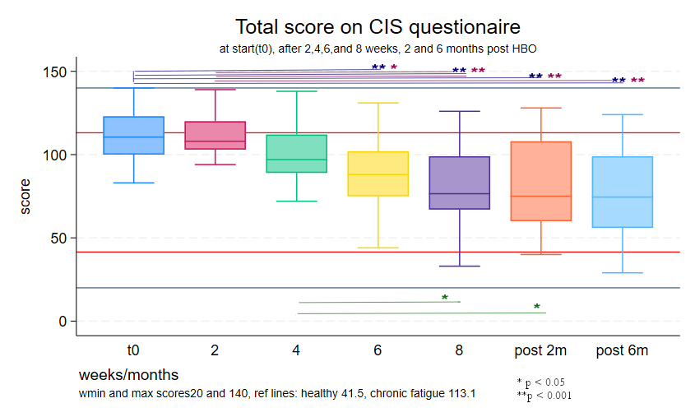
Is Hyperbaric oxygen therapy a possible treatment for Long COVID? Take home message
Ida Akkerman, Pieter-Jan van Ooij
HBO off label treatment for long covid
30 patients completed 40 HBOT sessions,
5 per week (8 weeks)
5 men, 25 women, with an mean age of 43.1 (10.9)
Average duration of condition was 23.9 (7.9) months
Complaints score on the Checklist Individual Strength (CIS) declined by 5 points per week on average.
An important limitation is lack of a control group. But considering the long time the patient had complaints it is unlikely these complaints would have declined this much spontaneously in 8 weeks.
Yes, HBOT for long covid is promising!

Slide 2
Introduction
Long COVID: some patients remain symptomatic for many months after the initial COVID-19 infection ^{1,2.}
Symptoms of Long COVID : fatigue, breathing problems, sleep problems, weakness, memory problems.
Etiology is not unraveled yet.
A definite treatment is not yet available.
So far, trials with Hyperbaric Oxygen Therapy (HBOT) show positive results^{3–8}.
Since 2022, HBOT has been an off-label treatment for long-term COVID patients in the Netherlands.

Slide 3
Methods
  Treatment
Hyperbaric oxygen therapy:
2.4 atm, four 20-min oxygen blocks
with three 5-min air breaks
5 days a week
8 weeks : 40 treatments
Patients paid for the treatments
  Outcome measure
Checklist Individual Strength (CIS). Measurement of fatigue, concentration, motivation and physical activity
before the start (T0), after 2, 4, 6, and 8 weeks
(thus 10,20,30,40 sessions)
and 2 and 6 months after the last HBO treatment
  Total score: sum of scores on all 20 questions
  (Severity of) Fatigue: questions 1,4,6,9,12,14,16,20
  Concentration (problems): questions 3,8,11,13,19
  (Decreased) Motivation: questions 2,5,15,18
  (Decreased) Physical Activity: questions 7,10,17

Slide 4
General data
Participation | Freq. | Percent
Completed 40 treatments | 30 | 53.57
of whom filled in the post 2 month questionnaire | 16
of whom filled in the post 6 month questionnaire | 8
Not finished yet | 7 | 12.50
Started but dropped out | 2 | 3.57
Finished at more than 30 but less than 40 treatments | 7 | 12.50
Total | 56 | 100.00
N |  | 30
Male sex | N (%) | 5 | (17)
Age (years) | Mean (sd) | 43.1 | (10.9)
Present Smoker | N (%) | 1 | (3.3)
Duration of long covid (time in months between infection and start of treatment) | Mean (sd) | 23.9 | (7.9)

Slide 5
Results
Figure 1 total score on CIS questionnaire during HBOT (n=30) and 2 months (n=16) and 6 month (n=8) after

Slide 6
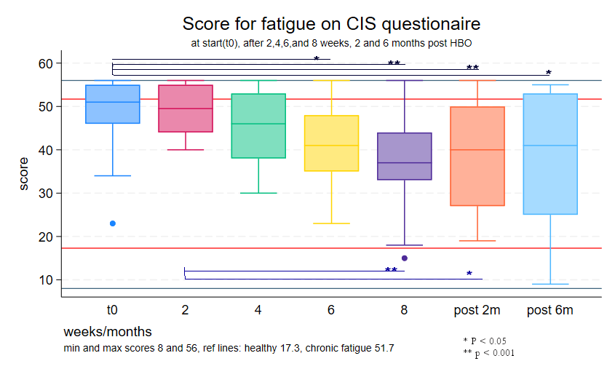
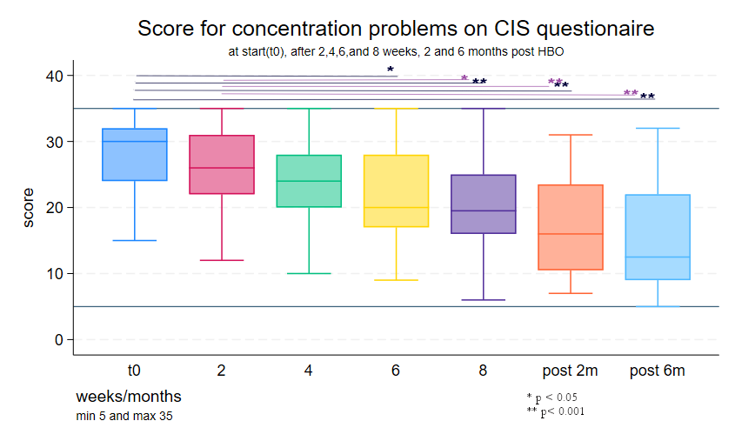
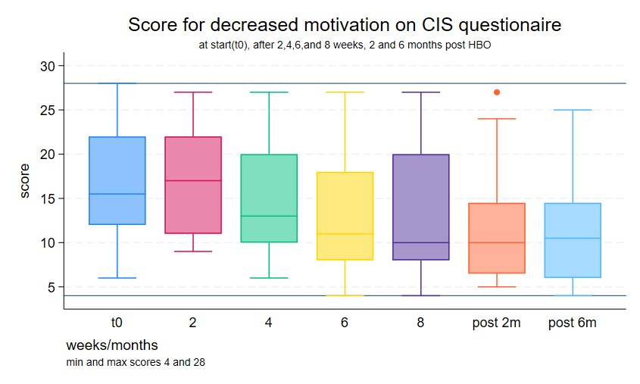
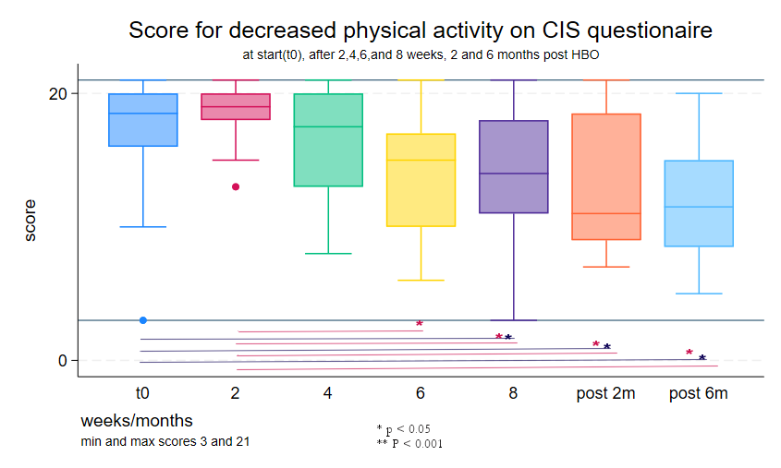
Results (2)
Figures 2-5. Scores on CIS questionnaire subscales during HBOT (n=30) and 2 months (n=16) and 6 month (n=8) after

Slide 7
Results (3)
Table 1 Number of participants with a score on the CIS questionnaire above a reference value
Reference | indication | at start of HBO |  | at end of HBO
 |  | N | % | N | %
Total score > 113.1 | Chronic fatigue syndrome⁹ | 13 | 43 | 4 | 13
Fatigue score > 17.3 | Chronic fatigue syndrome⁹ | 15 | 50 | 4 | 13
Total score > 76 | Risk of longtime absence of work ¹⁰ | 30 | 100 | 16 | 53

Slide 8
Results (4)
Table 2 Change in CIS scores during HBOT, results of generalized estimating equation (GEE)
GEE population-averaged model | Number of obs = 87
Group and time vars: id2 time | Number of groups = 23
Family: Gaussian | Obs per group:
Link: Identity | min = 3
Correlation: AR(1) | avg = 3.8
 | max = 4
 | Wald chi2(2) = 59.84
Scale parameter = 304.2137 | Prob > chi2 = 0.0000
score | Coefficient | Std. err. | z | P>|z| [95% conf.interval]
time (weeks) | -5.169085 | .7012041 | -7.37 | 0.000 | -6.54342 | -3.794751
score at start | .4876392 | .2143035 | 2.28 | 0.023 | .067612 | .9076664
_cons | 67.53271 | 23.97477 | 2.82 | 0.005 | 20.54303 | 114.5224

Slide 9
Discussion and conclusion
This study shows a significant decrease in reported long covid symptoms in 30 long covid patients, after 40 sessions of HBO therapy
The biological mechanism of long covid is unknown, therefore the effect cannot physiologically be explained.
Self reported outcome values might result in some bias, but in lack of a biochemical test, it does record symptoms of fatigue and concentration problems that are considered important in long covid
Ideally the treatment group should be compared with a control group, and double blinded. A sham treatment has limitations, and would ask a big effort of vulnerable patients, without outlook on success. A control group with no treatment or another treatment could have been possible but would limit the participants in trying another therapy.
Considering that the mean duration of long covid disease before participation is nearly 2 years, an improvement as shown here is unlikely to occur spontaneously in these 8 weeks.
These first results of treating long covid patient with hyperbaric therapy are very promising

Slide 10
Literature
1. Joli J, Buck P, Zipfel S, Stengel A. Post-COVID-19 fatigue: A systematic review. Front Psychiatry. 2022;13:947973. doi:10.3389/fpsyt.2022.947973
2. Davis HE, Assaf GS, McCorkell L, et al. Characterizing long COVID in an international cohort: 7 months of symptoms and their impact. EClinicalMedicine. 2021;38. doi:10.1016/j.eclinm.2021.101019
3. Leitman M, Fuchs S, Tyomkin V, Hadanny A, Zilberman-Itskovich S, Efrati S. The effect of hyperbaric oxygen therapy on myocardial function in post-COVID-19 syndrome patients: a randomized controlled trial. Sci Rep. 2023;13(1):9473. doi:10.1038/s41598-023-36570-x
4. Mrakic-Sposta S, Vezzoli A, Garetto G, et al. Hyperbaric Oxygen Therapy Counters Oxidative Stress/Inflammation-Driven Symptoms in Long COVID-19 Patients: Preliminary Outcomes. Metabolites. 2023;13(10). doi:10.3390/metabo13101032
5. Zilberman-Itskovich S, Catalogna M, Sasson E, et al. Hyperbaric oxygen therapy improves neurocognitive functions and symptoms of post-COVID condition: randomized controlled trial. Sci Rep. 2022;12(1):11252. doi:10.1038/s41598-022-15565-0
6. Kitala D, Łabu W, Kozielski J, et al. Preliminary Research on the Effect of Hyperbaric Oxygen Therapy in Patients with Post-COVID-19 Syndrome. J Clin Med. 2022;12(1). doi:10.3390/jcm12010308
7. Robbins T, Gonevski M, Clark C, et al. Hyperbaric oxygen therapy for the treatment of long COVID: early evaluation of a highly promising intervention. Clinical Medicine, Journal of the Royal College of Physicians of London. 2021;21(6):E629-E632. doi:10.7861/clinmed.2021-0462
8. García Estévez DA, López Pérez Á, Gómez Márquez H. Hyperbaric oxygen therapy in long-COVID-19 disease. Med Clin (Barc). 2023;161(11):498-499. doi:10.1016/j.medcli.2023.06.046
9. Schulte-Van Maaren YWM, Giltay EJ, Van Hemert AM, et al. Reference values for the Body Image Concern Inventory (BICI), the Whitely Index (WI), and the Checklist Individual Strength (CIS-20R): The Leiden Routine Outcome Monitoring Study. J Affect Disord. 2014;164:82-89. doi:10.1016/J.JAD.2014.03.013
10. De Vries J, Michielsen HJ, Van Heck GL. Assessment of fatigue among working people: a comparison of six questionnaires. Occup Environ Med. 2003;60(Suppl 1):i10. doi:10.1136/OEM.60.SUPPL_1.I10

